Slide 1

A NEW REVOLUTIONARY SYSTEM TO DETECT HUMAN BEINGS BURIED UNDER THE EARTHQUAKE RUBBLE
PRESENTED BY Dr.SRINIVASA RAO NUKALA
SMIEEE; PAST CHAIR-MTT-S
PROFESSOR OF ECE-Matrusri Engg College; Saidabad-Hyderabad-500059

Slide 2

ABSTRACT
“Thousands of persons killed as a cause of earthquake”.
The above words aren’t the headlines of the newspaper but daily news everyone come across whenever we go through a newspaper or watching over a TV news.
A person’s life is precious and meaningful to his loved ones.

Slide 3

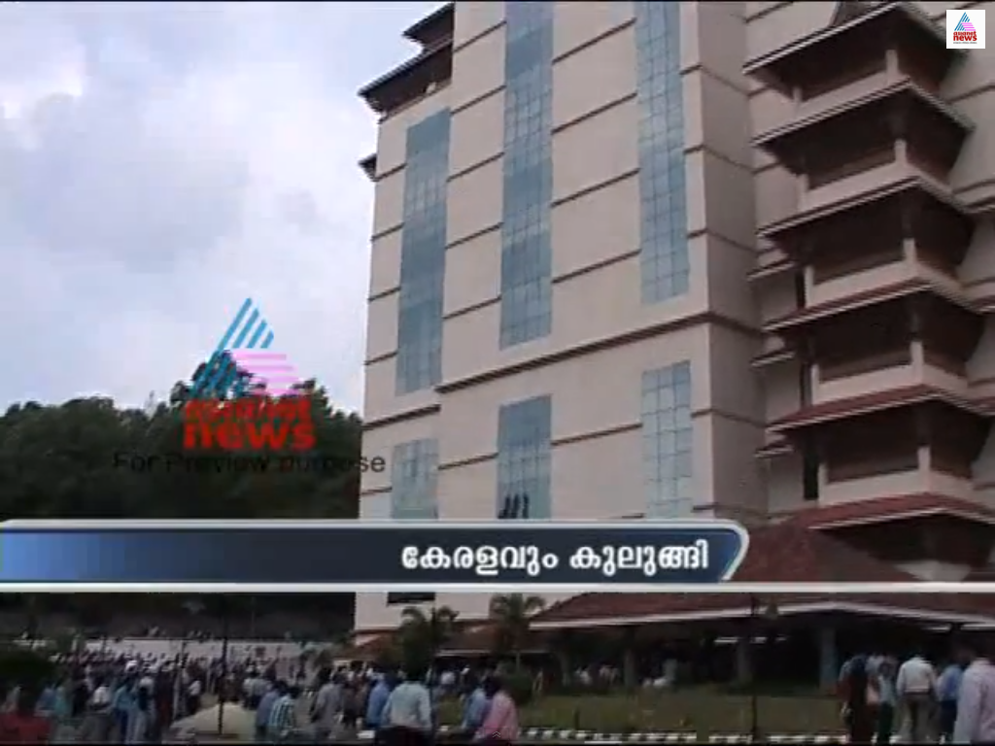
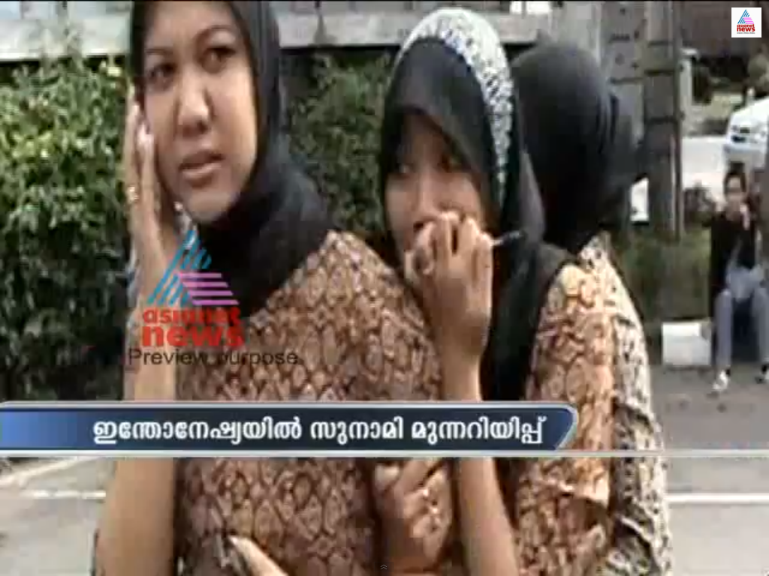

Slide 4

We, as responsible Engineers felt a part of society to bring a system to avoid these mishaps.
With the meteoric Embedded systems along with microprocessor our designed system is preventing deaths and providing safe guided measures.
A new revolutionary microwave life detection system, which is used to locate human beings buried under earthquake rubble, has been designed.

Slide 5
This system operating at certain frequency can remotely detect the breathing and heartbeat signals of human beings buried under earthquake rubble.
By proper processing of these signals, the status of the person under trap can be easily judged.
The entire process takes place within a few seconds as the system is controlled by a microprocessor (8085) or microcontroller unit.
By advent of this system the world death rate may decrease to greater extent as large percentage of death occur due to earthquake.

Slide 6
INTRODUCTION
At present as we all know the need of the hour is to find an effective method for rescuing people buried under earthquake rubble (or) collapsed building.
It has to be done before we experience another quake.
Present methods for searching and rescuing victims buried (or) trapped under earthquake rubble are not effective.
Taking all the factors in mind, a system, which
will be really effective to solve the problem, has been designed.

Slide 7

RECENT NEWS
Strong Earthquake hits JAPAN and more than 500 people have died in an earthquake under the rubble`s.
The disaster in the New York`s city at World Trade Center claimed lives of more than 5000 people.

Slide 8

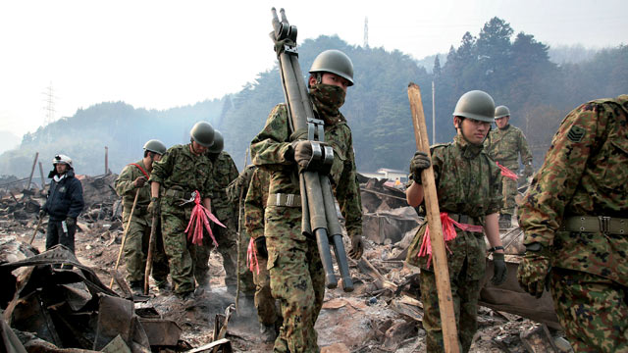
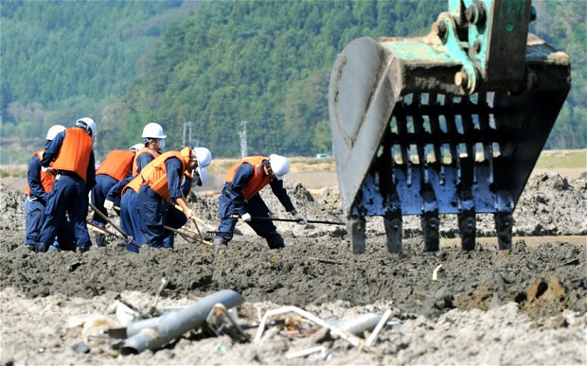
RECENT PHOTOS

Slide 9



Slide 10
COLLAPSED BUILDING
REFLECTED BEAM
LIFE DETECTION SYSTEM
MICROWAVE BEAM

Slide 11
The basic principle is that when a microwave beam of certain frequency [L (or) S band (or) UHF band] is aimed at a portion of rubble (or) collapsed building under which a person has been trapped, the microwave beam can penetrate through the rubble to reach the person. When the microwave beam focuses the person, the reflected wave from the person’s body will be modulated (or) changed by his/her movements, which include breathing and
heartbeat. Simultaneously, reflected waves are also received from the collapsed structures.

Slide 12
So, if the reflected waves from the immovable debris are cancelled and the reflected wave from the person’s body is properly distinguished, the breathing and heartbeat signals can be detected.
By proper processing of these signals, the status of the person under trap can be easily judged.
Thus a person under debris can be identified.

Slide 14
CIRCUIT
DIAGRAM

Slide 15
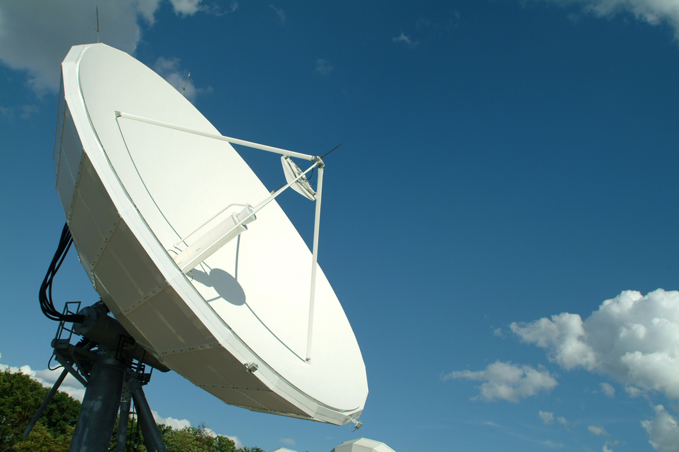
MAJOR COMPONENTS OF THE CIRCUIT
The microwave life detection system has four major components. They are:
1.A microwave circuit which generates, amplifies and distributes microwave signals to different microwave components.
2. A microwave controlled clutter cancellation system, which creates an optimal signal to cancel the clutter from the rubble.

Slide 16
3. A dual antenna system, which consists of two antennas, energized sequentially.
4. A laptop computer which controls the microprocessor and acts as the monitor.

Slide 17
WORKING FREQUENCY
The frequency of the microwave falls under two categories, depending on the type and nature of the collapsed building.
They are :
1. L (or) S band frequency say 1150 MHz
2. UHF band frequency say 450 MHz

Slide 18
CIRCUIT DESCRIPTION
The circuit description is as follows:
1.Phase locked oscillator:
The phase locked oscillator generates a very stable electromagnetic wave say 1150 MHz with output power say 400mW.
2.Directional coupler 1 (10 dB):
This wave is then fed through a 10 dB directional coupler and a circulator before reaching a radio frequency switch, which

Slide 19
energizes the dual antenna system. Also, the ten dB directional coupler branches out one-tenth of the wave (40mW) which is then divided equally by a directional coupler 2 (3 dB).
3. Directional coupler 2 (3 dB):
One output of the 3 dB directional coupler 2 (20mW) drives the clutter cancellation unit.
Other output (20mW) serves as a local reference signal for the double balanced mixer.

Slide 20
4.Antenna system:
The dual antenna system has two antennas, which are energized sequentially by an electronic switch. Each antenna acts separately.
5.Clutter cancellation system:
The clutter cancellation unit consists of
1. A digitally controlled phase shifter I
2. A fixed attenuator
3. A RF amplifier
4. A digitally controlled attenuator.

Slide 21
WORKING
Clutter cancellation of the received signal:
1) The wave radiated by the antenna 1 penetrates the earthquake rubble to reach the buried person.
2) The reflected wave received by the antenna 2 consists of a large reflected wave from the rubble and a small-reflected wave from the person’s body.
3 ) The large clutter from the rubble can be cancelled by a clutter-cancelling signal.

Slide 22
4 ) The small reflected wave from the person’s body couldn’t be cancelled by a pure sinusoidal cancelling because his/her movements modulate it.
5 ) The output of the clutter cancellation circuit is automatically adjusted to be of equal amplitude and opposite phase as that of the clutter from the rubble.
6 ) Thus, when the output of the clutter cancellation circuit is combined with the directional coupler 3 (3 dB), the large clutter from the rubble is completely cancelled.

Slide 23
7 ) Now, the output of the directional coupler 3 (3 dB) is passed through a directional coupler 4 (6 dB).
8 ) One-fourth of the output directed is amplified by a RF pre-amplifier and then mixed with a local reference signal in a double balanced mixer.
9 ) Three-fourth of the output is directed by a microwave detector to provide dc output, which serves as the indicator for the degree of the clutter cancellation.
10 ) When the settings of the digitally controlled phase shifter and the attenuator are swept the microprocessor control system, the output of the microwave detector varies accordingly.

Slide 24
Demodulation of the clutter cancelled signal:
1.At the double balanced mixer, the amplified signal of the reflected wave from the person’s body is mixed with the local reference signal.
2.The phase of the local reference signal is controlled by another digitally controlled phase shifter 2 for an optimal output from the mixer.
3.The output of the mixer consists of the breathing and heartbeat signals of the human plus some avoidable noise.

Slide 25
4.This output is fed through a low frequency amplifier and a band pass filter (0.4 Hz) before displayed on the monitor.
5.The function of the digitally controlled phase shifter 2 is to control the phase of the local reference signal for the purpose of increasing the system sensitivity.
6.The reflected signal from the person’s body after amplification by the pre-amplifier is mixed with the local reference signal in a double balanced mixer.

Slide 26


Microprocessor Control Unit:
The algorithm and flowcharts for the antenna system and the clutter cancellation system are as follows:
Antenna system:
1.Initially the switch is kept in position 1 (signal is transmitted through the antenna 1)
2.Wait for some predetermined sending time, Ts
3.Then the switch is thrown to position 2 (signal is received through the antenna 2)
4.Wait for some predetermined receiving time, Tr
5.Go to step 1
6.Repeat the above procedure for some predetermined time, T.

Slide 27
Clutter cancellation system:
1. Send the signal to the rubble through antenna 1.
2. Receive the signal from the rubble through antenna 2.
3. Check the detector output. If it is within the predetermined limits go to step 5.
4. Otherwise send the correction signal to the digitally controlled phase shifter 1 and attenuator and go to step 1.
5. Check the sensitivity of the mixer. If the optimum go to step 7.
6. Otherwise send the correction signal to the digitally controlled phase shifter 2 to change the phase and go to step 1.
7. Process the signal and send it to the laptop.

Slide 28
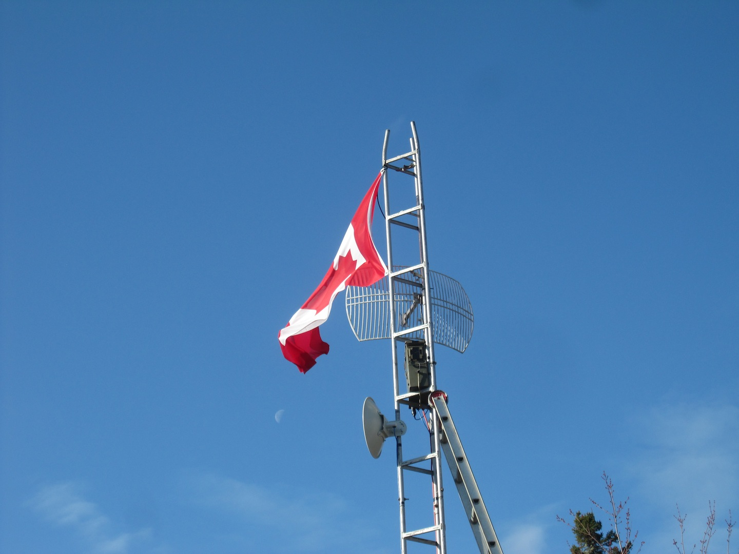
FLOW CHART FOR ANTENNA SYSTEM

Slide 29
CLUTTER CANCELATION SYSTEM
LUTTER CANCELATION SYSTEM

Slide 30

Advantages Of L (Or) S Band Frequency System:
Microwaves of L (or) S band frequency can penetrate the rubble with metallic mesh easier than that of UHF band frequency waves.
Advantages Of Uhf Band Frequency System:
Microwaves of UHF band frequency can penetrate deeper in rubble (without metallic mesh) than that of L (or) S band frequency waves.
Frequency Range Of Breathing And Heartbeat Signal:
The frequency range of heartbeat and breathing signals of human beings lies between 0.2 and 3 Hz.

Slide 31

Highlights:
1. The location of the person under the rubble can be known by calculating the time lapse between the sending time, Ts and receiving time, Tr.
2. Since it will not be possible to continuously watch the system under critical situations, an alarm system has been set, so that whenever the laptop computer system processes the received signal and identifies that there is a human being, the alarm sound starts.
3. Also under critical situations, where living beings other than humans are not required to be found out, the system can detect the signals of other living beings based on the frequency of the breathing and heartbeat signals.

Slide 32
4.Therefore, The proposed method is an efficient method which not only detect life signals but also the identification of people in a given area , to facilitate rescue team operations in case of any emergencies.

Slide 33
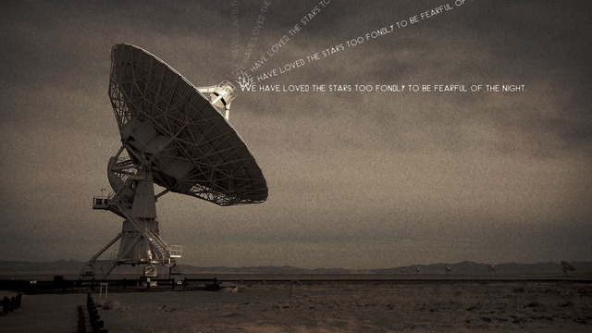
RESULT

Slide 34

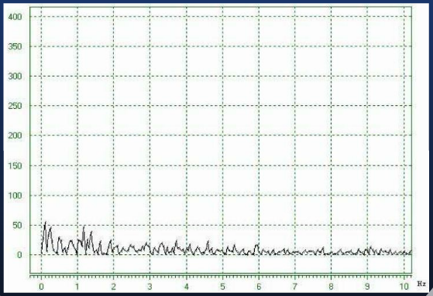
FREQUENCY SPECTRUM OF BACKGROUND NOISE

Slide 35
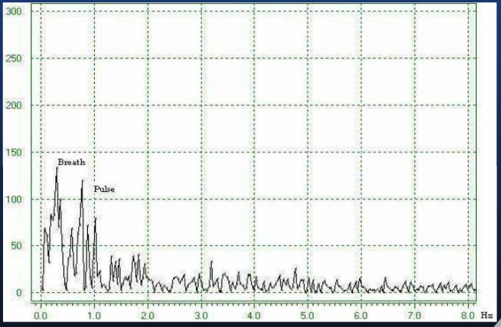
FREQUENCY SPECTRUM OF HEARTBEAT AND BREATH

Slide 36
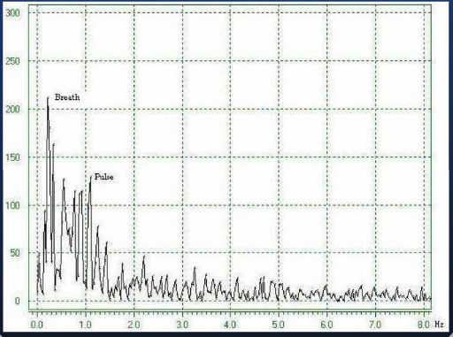
FREQUENCY SPECTRUM OF HEARTBEAT AND BREATH

Slide 37
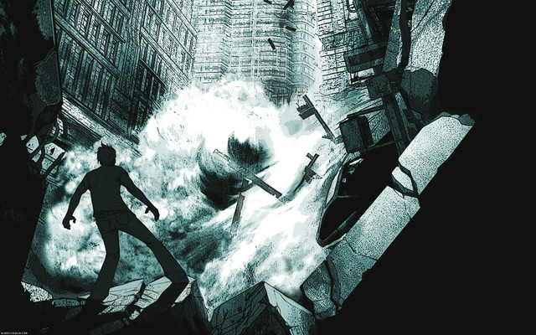
CONCLUSION:
Thus a new sensitive life detection system using microwave radiation for locating human beings buried under earthquake rubble (or) hidden behind various barriers has been designed. This system
operating either at L (or) S band, UHF band can detect the breathing and heartbeat signals of human beings buried under earthquake rubble. By the advent of this system the world death rate as a cause of natural disaster may decrease to a great extent.

Slide 38
SUPPORTING VIDEOS:

Slide 39

THANK YOU

