Slide 1
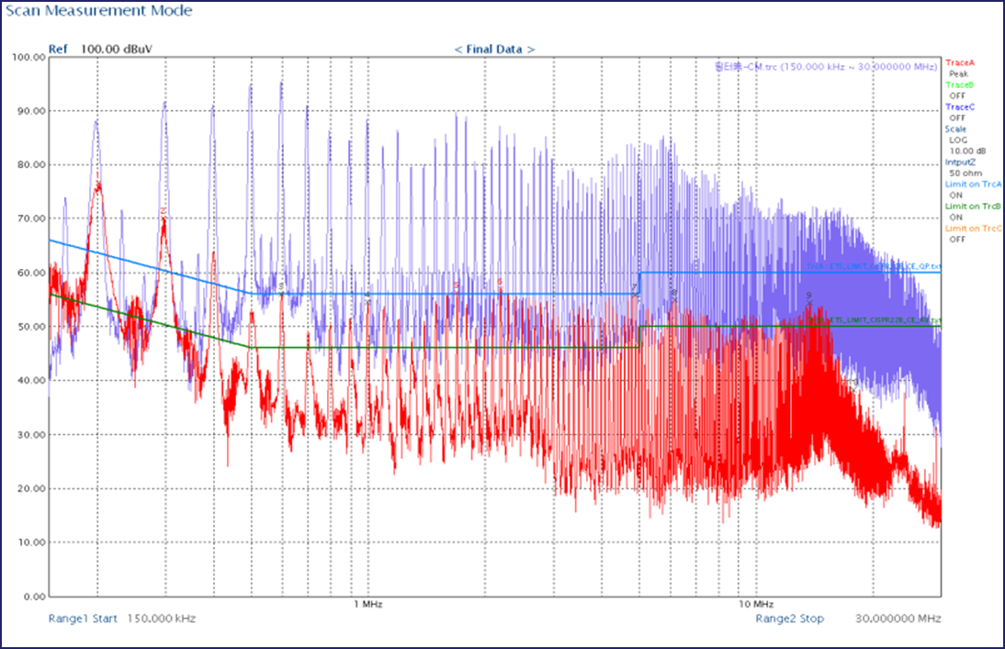
Entrance to EMI

Slide 2
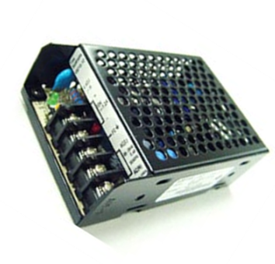
What is EMC/EMI
Classification of EMC
EMI : Electro-Magnetic Interference
EMS : Electro-Magnetic Susceptibility
CE(RE) : Conducted(Radiated) Emission
CS(RS) : Conducted(Radiated) Susceptibility
CM : Common-Mode Component
DM : Differential-Mode Component
EMC
(Electro-Magnetic Compatibility)
EMI
(Emission)
EMS
(Immunity)
CE
RE
CS
RS
RE
CM
DM
CE
EUT(DUT)
EMC has verified / classified by its characteristics and the co-relation with EUT
This presentation is concentrated on CE of EMI, especially for CM and DM in CE
EUT(DUT) = Equipment Under Test (Device Under Test)

Slide 3
What is EMI
Classification of EMI
Conducted RF Disturbance
(CE)
Power
Disturbance
Acoustic Noise
16Hz
60Hz
2.4KHz
20KHz
150KHz
30MHz
300MHz
1GHz
Sub Harmonics
Harmonics
Radiated Disturbance
(RE)
9KHz
Lighting device
The Classification of EMC is done by frequency range
The range is being changed by introducing new EUT, day by day
World-wide and/or each country has the regulation/standard of EMC/EMI related and any of EUT has controlled by such regulation/standard
Mostly familiar regulation/standard are
CISPR(The International Special Committee On Radio Interference)
EN (European Norm)
FCC (Federal Communications Commission)
IEC (International Electrotechnical Commission)

Slide 4
What CE and CM / DM
EMI
(Emission)
CE
RE
CE
Power In
Power Out
CM
DM
EUT
Conducted Disturbance
(CE)
Radiated Disturbance
(RE)
9KHz
150KHz
30MHz
1.1GHz
????
300MHz
CE -- Noise moved through the line(s) to EUT
CM : Common-Mode Noise
= Noise Line to Ground
DM : Differential-Mode Noise
= Noise Line to Line
Line
DM Noise
CM Noise
CM Noise
Neutral
CM Noise
DM Noise
Ground

Slide 5
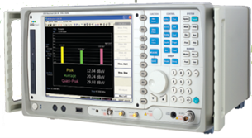
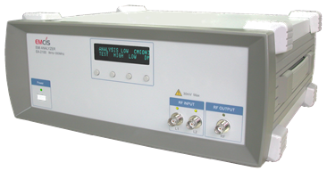
Measurement of the Noise(s)
EMI Receiver
LISN
Measurement is done by EMI Receiver – Occasionally done by Spectrum Analyzer, but not recommended
Basic equipment are EMI receiver and LISN(Line Impedance Stabilization Network)
Configuration and Setup of Measurement equipment be decided / done by
-- what kind of EUT to be measured
-- which regulation/standard is applied
LISN has various models, according to the power condition(of EUT), like 16A to 200A, 1ph to 3ph
Measurement is recommended to select/choose a place, having minimized outer noise influence, like in chamber or mini-shield room.

Slide 6
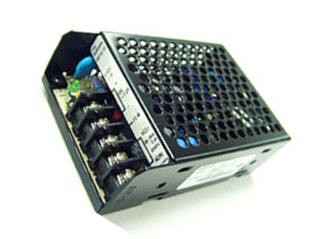
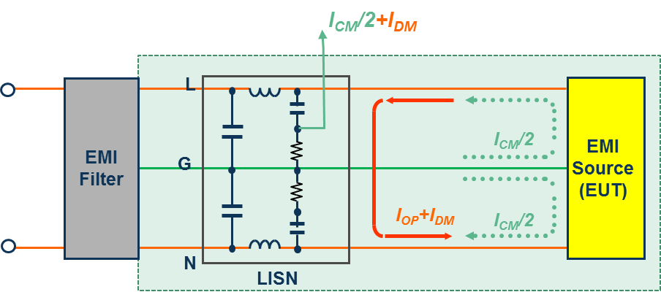
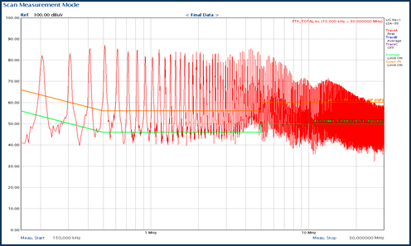
Measurement of the Noise(s)
EMI Receiver
LISN
EUT
Measured results
Differential-Mode(DM)
Total Noise = CM + DM
Common-Mode(CM)

Slide 7
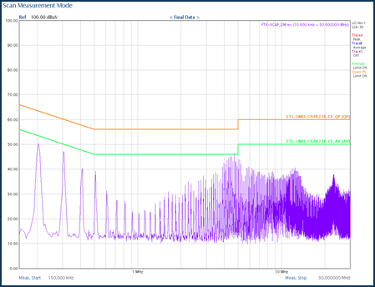
What is EMI Debugging
Debugging Process
Over the Limit Line (total noise)
Solved = Debugged
Solution = Debugging is to reduce/control the noise under the limit lines.
Limit Lines
Level & Shape of Limit Lines are determined by the regulation/standard, applied on EUT
There are 3 types of Limit Lines ;
Peak, Quasi-Peak, and Average
In Certification/Approval (from lab), two limit lines are used, Quasi-Peak and Average
In debugging, Peak limit line is used.
Magnitude
(dBμV)
Peak
Quasi-Peak
Average
Peak < Quasi-Peak < Average
Frequency
Between 150KHz to 30MHz, Peak is always the highest level

Slide 8
What is EMI Debugging
How to Reduce the Noise(s)
Various way of methods can be considered/applied to reduce the noise(s)
Below are some of mostly used method/consideration
Recommended the Filter should be the LAST solution
Pattern
Actual in the field
= EMI Solution/Debugging is the last,
after EUT design is finished
The Ideal approach
To achieve most recommended EMI Solution/Debugging,
EMI consideration/design should be started at the same time
of EUT design
Wiring
Do not do the wire twisted
Allocate wires be separated, as far as possible
Position
Filter should be located at the “just” entrance of power input
EMI Filter
Power Input
EUT
Shielding
Shield any components, causing noises,
Separate the components with shielding materials
Filters : The Last & Final Solution = Debugging

Slide 9
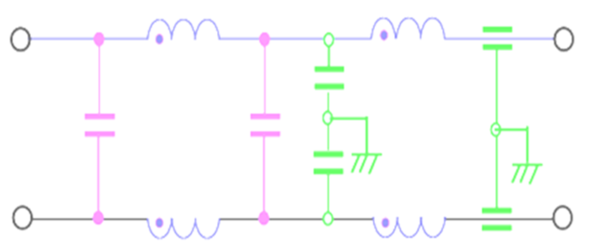
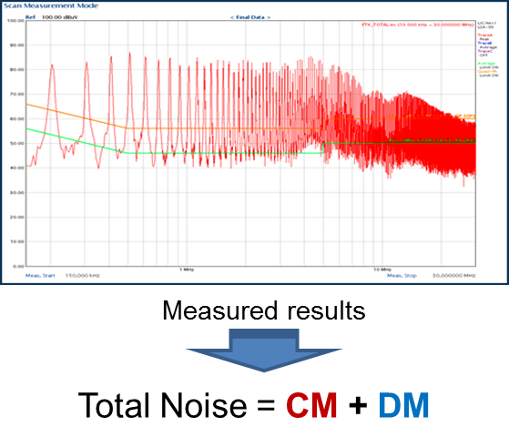
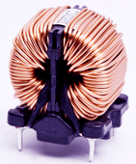
What is EMI Debugging
Why EMI Debugging is Difficult - Filter Design
Measured Noise = Total Noise = CM + DM
Filter is consisted with two types of components
Common-Mode Group -- CM Coil and Y-Capacitor
Differential-Mode Group -- DM Coil and X-Capacitor

Slide 10
What is EMI Debugging
Why EMI Debugging is Difficult - Filter Design
How to determine the noise is CM or DM, from the measured noise, total noise ???
Experience
Know-How
How to select the components ???
Know-How
Experience
How fast the components selection can be done ???
Experience
Know-How
How to be sure the selected components are accurate & exact size for the solution ???
Know-How
Experience

Slide 11
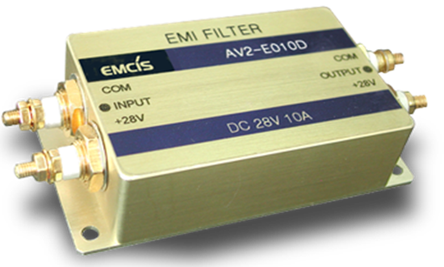
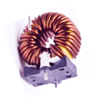
What is EMI Debugging
Summary of EMI Solution = Debugging = EMI Filter Design
Analysis and Measurement of Exact Noise by mode, CM and DM
EMI Solution = Debugging is finalized by EMI Filter (EMI Filter Design)
Understanding more and more about the components being used on EMI Filter
Design EMI Filter, using smaller Components and less Quantity
Successful EMI Debugging = Good & Fast Filter Design
COST SAVING = COMPETITIVENESS

Slide 12
Solution - EMCIS
Consideration to make EMI Debugging as EASY WORK
MEASURE the noises by mode, CM and DM, respectively
SELECT the components in exact size and performance, mode by mode
SIMULATE the performance of the components and the filter
APPLY the selected components as “Primary” filter to EUT

Slide 13
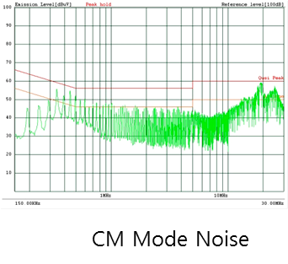
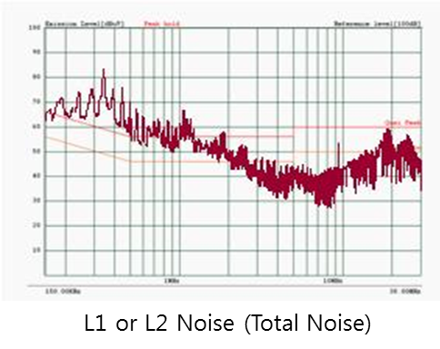
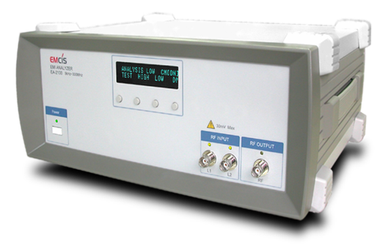
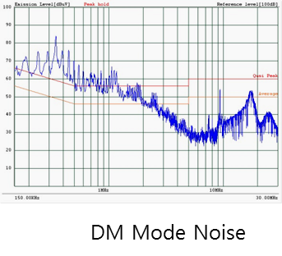
Solution - EMCIS
EMCIS Solution ; EA-2100
EMI Analyzer
(EA-2100)
Measure each of noises, CM and DM, respectively
Select Components per each Mode, CM and DM, one by one
Apply selected components as “Primary” filter to EUT

Slide 14
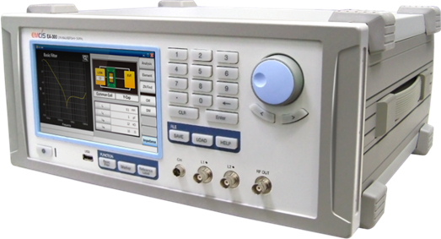
Solution - EMCIS
EMCIS Solution ; EA-300
EMI Analyzer
(EA-300)
Measure each of noises, CM and DM, respectively
Select Components per each Mode, CM and DM, one by one
Simulate the performance of the selected components and also the designed filter
Apply selected components as “Primary” filter to EUT

